Slide 1

चरैवेति, चरैवेति
Keep progressing to attain a higher self.
avinash.bhagat@lpu.co.in Avinash Bhagat 9463281930

Slide 2
CAP275: Data Communication and Networking
Lecture # 20
MAC Protocols
avinash.bhagat@lpu.co.in Avinash Bhagat 9463281930

Slide 3

Data Link Layer

Slide 4
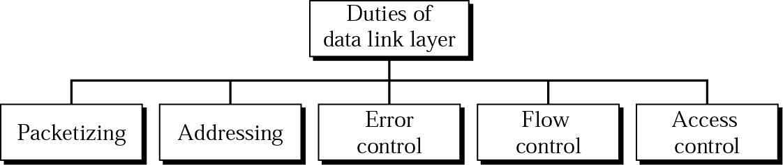
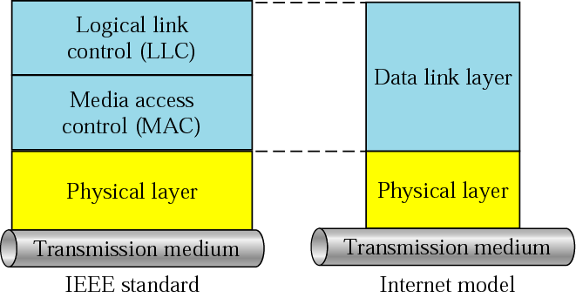
LLC and MAC sublayers

Slide 5
Multiple Access
Problem: When two or more nodes transmit at the same time, their frames will collide and the link bandwidth is wasted during collision
  How to coordinate the access of multiple sending/receiving nodes to the shared link???
Solution: We need a protocol to coordinate the transmission of the active nodes

Slide 6
Multiple Access
What is expected from Multiple Access Protocols:
  Main task is to minimize collisions in order to utilize the bandwidth by:
    Determining when a station can use the link (medium)
    what a station should do when the link is busy
    what the station should do when it is involved in collision
Notes:
These protocols are called Medium or Multiple Access Control (MAC) Protocols belong to a sublayer of the data link layer called MAC (Medium Access Control)

Slide 7

Multiple Access
For wireless

Slide 8
Random Access
Random Access (or contention based ) Protocols:
  No station is superior to another station and none is assigned the control over another.
  No station permits, or does not permit,
  another station to send.
  At each instance, a station that has data to send uses a procedure
  defined by the protocol.
Notes:
Two features give this method its name.
There is no scheduled time for a station to transmit. Transmission is random among the stations. That is why these methods are called random access.
No rules specify which station should send next. Stations compete with one another to access the medium. That is why these methods are also called contention methods.

Slide 9
Random Access → ALOHA Protocols
Pure ALOHA Protocol
Slotted ALOHA Protocol
Notes:
ALOHA, the earliest random access method, was developed at the University of Hawaii in early 1970. It Was designed for wireless LAN and can be used for any shared medium

Slide 10
Pure ALOHA Protocols
  All frames from any station are of fixed length (L bits)
  Stations transmit at equal transmission time (all stations produce frames with equal frame lengths).
  A station that has data can transmit at any time

Slide 11
Pure ALOHA Protocols
  After transmitting a frame, the sender waits for an acknowledgment for an amount of time (time out) equal to the maximum round-trip propagation delay
  If no ACK was received, sender assumes that the frame or ACK has been destroyed and resends that frame after it waits for a random amount of time

Slide 12

Procedure for pure ALOHA protocol

Slide 13

Frames in a pure ALOHA network

Slide 14
Pure ALOHA Protocols
  If station fails to receive an ACK after repeated transmissions, it gives up
  ALOHA Maximum channel utilization is 18%

Slide 15

Vulnerable time for pure ALOHA protocol

Slide 16
Random Access – Slotted ALOHA
Time is divided into slots equal to a frame transmission time (T_{fr})
A station can transmit at the beginning of a slot only
If a station misses the beginning of a slot, it has to wait until the beginning of the next time slot.
A central clock or station informs all stations about the start of a each slot
Maximum channel utilization is 37%

Slide 17

Frames in a Slotted ALOHA network

Slide 18

Vulnerable time for Slotted ALOHA protocol

Slide 19
Advantage of ALOHA protocols
  A node that has frames to be transmitted can transmit continuously at the full rate of channel (R bps) if it is the only node with frames
  Simple to be implemented
  No master station is needed to control the medium

Slide 20
Disadvantage
  If (M) nodes want to transmit, many collisions can occur and the rate allocated for each node will not be on average R/M bps
  This causes low channel utilization 36.8% and 18.4%

Slide 21
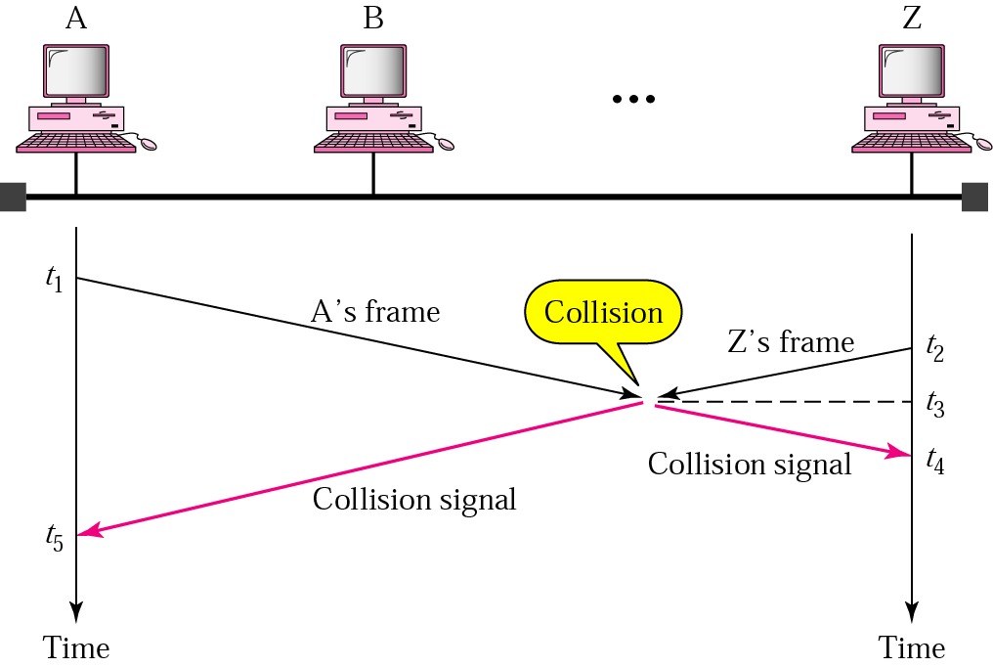
Random Access – Carrier Sense Multiple Access (CSMA)
Notes:
To minimize the chance of collision and, therefore, increase the performance, the CSMA method was developed.
The chance of collision can be reduced if a station senses the medium before trying to use it.
Carrier sense multiple access (CSMA) requires that each station first listen to the medium (or check the state of the medium) before sending. In other
words, CSMA is based on the principle "sense before transmit" or "listen before talk.
CSMA can reduce the possibility of collision, but it cannot eliminate it.
The reason for this is stationsare connected to a shared channel . The possibility of collision still exists because of propagation delay;

Slide 22

Random Access – Carrier Sense Multiple Access (CSMA)
Vulnerable time for CSMA is the maximum propagation time
The longer the propagation delay, the worse the performance of the protocol because of the above case.

Slide 23
Types of CSMA Protocols
    Non-Persistent CSMA
    1-Persistent CSMA
    p-Persistent CSMA
Notes:
Different CSMA protocols that determine:
What a station should do when the medium is idle?
What a station should do when the medium is busy?

Slide 24

Flow diagram for three persistence methods

Slide 25
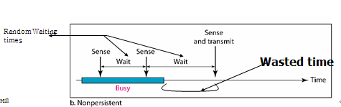
Nonpersistent CSMA
A station with frames to be sent, should sense the medium
  If medium is idle, transmit; otherwise, go to 2
  If medium is busy, (backoff) wait a random amount of time and repeat 1

Slide 26
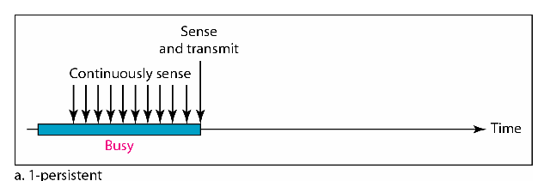
1-persistent CSMA
To avoid idle channel time, 1-persistent protocol used
Station wishing to transmit listens to the medium:
  If medium idle, transmit immediately;
  If medium busy, continuously listen until medium becomes idle; then transmit immediately with probability 1
Performance
  1-persistent stations are selfish
  If two or more stations becomes ready at the same time, collision guaranteed

Slide 27
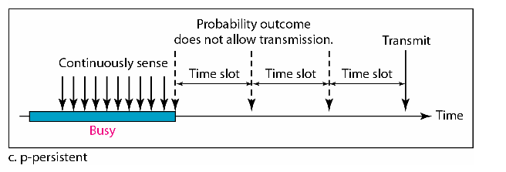
P-persistent CSMA
Time is divided to slots where each Time unit (slot) typically equals maximum propagation delay
Station wishing to transmit listens to the medium:
If medium idle,
  transmit with probability (p), OR
  wait one time unit (slot) with probability (1 – p), then repeat 1.
If medium busy, continuously listen until idle and repeat step 1
Performance
  Reduces the possibility of collisions like nonpersistent
  Reduces channel idle time like 1-persistent

Slide 28
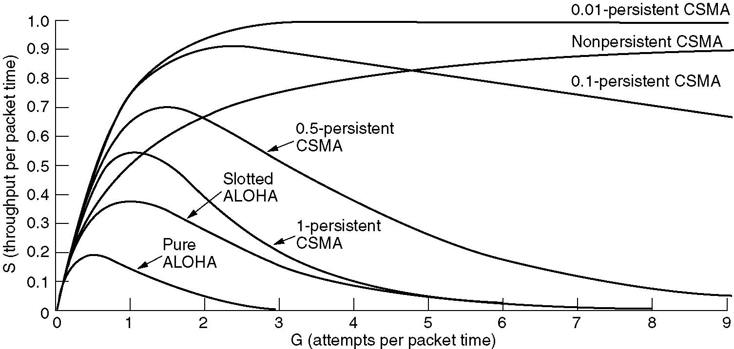
Persistent and Nonpersistent CSMA
Comparison of the channel utilization versus load for various random access protocols.

Slide 29
CSMA/CD (Collision Detection)
CSMA (all previous methods) has an inefficiency:
  If a collision has occurred, the channel is unstable until colliding packets have been fully transmitted
CSMA/CD (Carrier Sense Multiple Access with Collision Detection) overcomes this as follows:
  While transmitting, the sender is listening to medium for collisions.
  Sender stops transmission if collision has occurred reducing channel wastage .
CSMA/CD is Widely used for bus topology LANs (IEEE 802.3, Ethernet).

Slide 30

CSMA/CD (Collision Detection)
Notes:
In CSMA, if 2 terminals begin sending packet at the same time, each will transmit its complete packet (although collision is taking place).
Wasting medium for an entire packet time.

Slide 31

Collision and abortion in CSMA/CD

Slide 32

Flow diagram for CSMA/CA

Slide 33

Flow diagram for the CSMA/CD

Slide 34
CSMA/CD (CSMA with Collision Detection)
CSMA/CD
Step 1: If the medium is idle, transmit
Step 2: If the medium is busy, continue to listen until the channel is idle, then transmit
Step 3: If a collision is detected during transmission, cease transmitting
Step 4: Wait a random amount of time and repeats the same algorithm
Notes:
In CSMA, if 2 terminals begin sending packet at the same time, each will transmit its complete packet (although collision is taking place).
Wasting medium for an entire packet time.

Slide 35
References :
Text Book:
  Behrouz A. Forouzan, Data Communication and networking, 4th Ed., Tata McGraw Hills year of publication 2006
Other Specific Book:
  Andrew S. Tanenbaum,Computer Network 2nd Edition, PHI, Third Edition 1997
  Comer E. Doughlas,Computer Networks and Internets, 2nd Ed., Pearson, 2000
  W. Stallings,Data and Computer Communications, 7th Ed., Pearson, 2002.

Slide 36

See you in next class

